Slide 1

Kickstarter Data Analysis Report
By
Ansh Anand
Chi Cheong Lui
Jason Tran
Mahumd Iqbal Halim
Sahand Saremi

Slide 2
Agenda
Overview of Kickstarter
Data Source
Definition of success
Analysis by Category
Analysis by Time
Analysis by $$$ Pledged
Any correlation…
Conclusion

Slide 3
Overview of Kickstarter
Launched on April 28, 2009
The MISSION: to help bring creative projects to life
Some statistics (on www.kickstarter.com as of 2018/12)
Total dollars pledged : 4.05 Billions
Total backers : 15 Millions (about 5M are repeat backers)
Launched Projects : 428,166
Successfully funded projects : 155,476
Overall success rate : 36.60%

Slide 4
Data Source
Data Source: www.kaggle.com
Number of records : 378,661
Date Range: 2009/04 – 2018/01

Slide 5
Definition of a Successful Project
Every project creator sets their project’s funding goal and deadline.
The project succeeds if its funding goal is reached by the deadline.

Slide 6
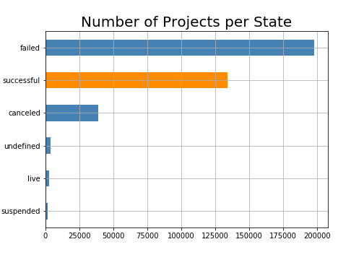
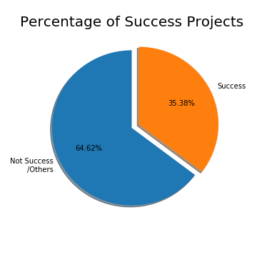
State of Project

Slide 7
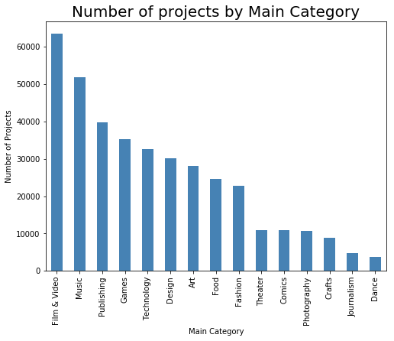
Analysis by Category
Notes:
The projects are categorized into 15 main categories
Top 3 categories :
Film & Video
Music
Publishing
Bottom 3 categories:
Crafts
Journalism
Dance

Slide 8
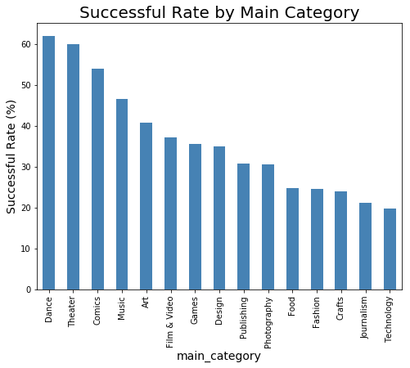
Success Rate by Category

Slide 9
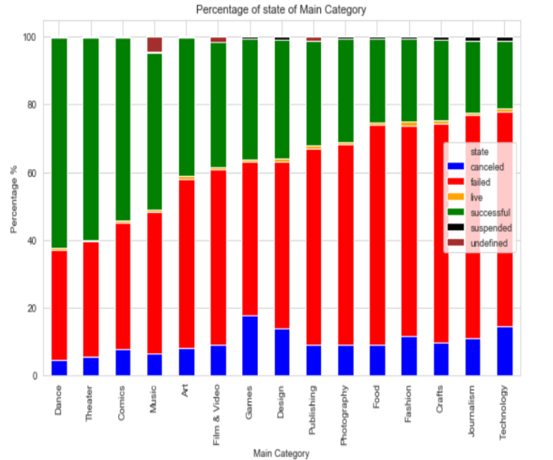

Slide 10
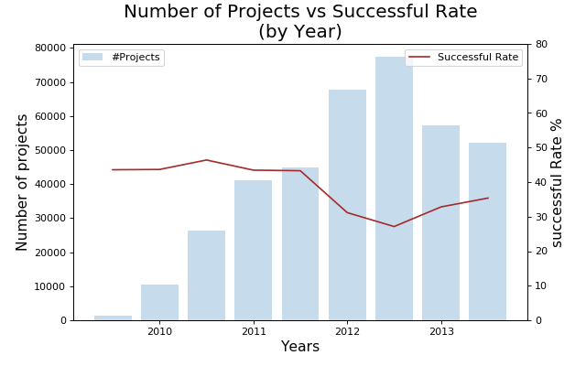

Slide 11
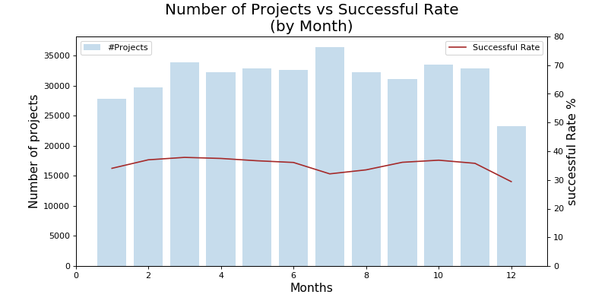

Slide 12
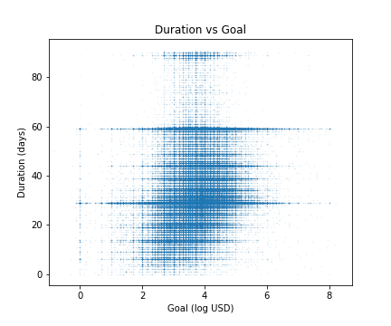

Slide 13
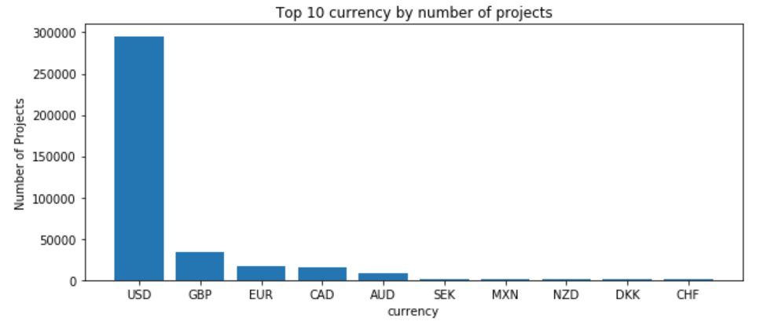
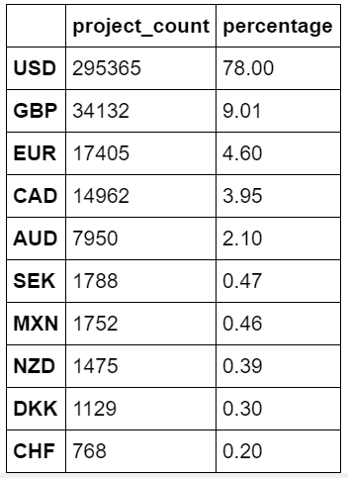

Slide 14
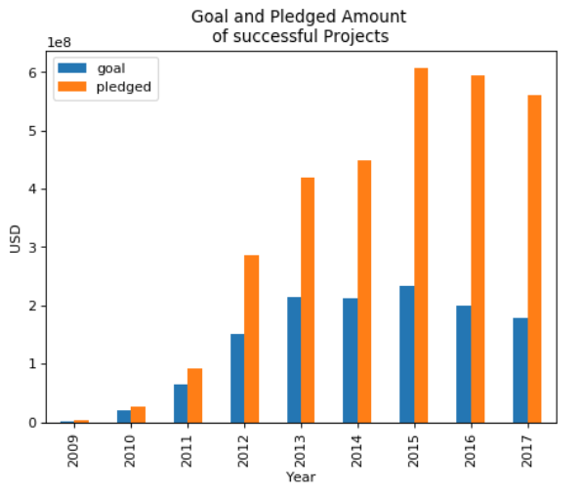

Slide 15
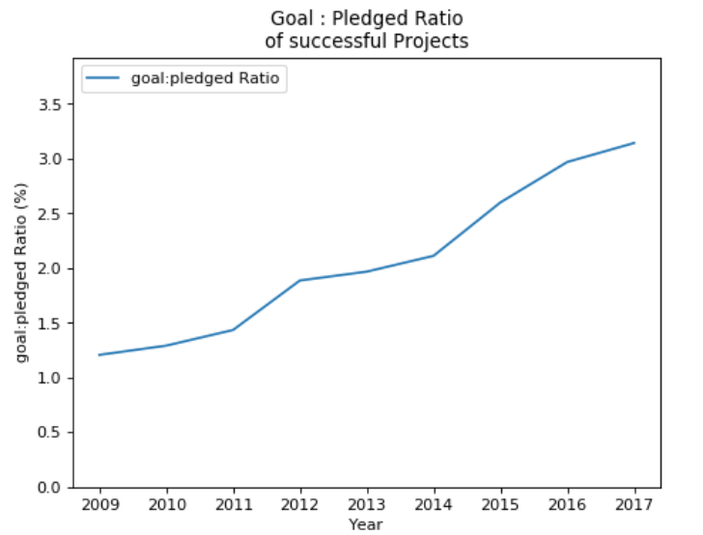

Slide 16
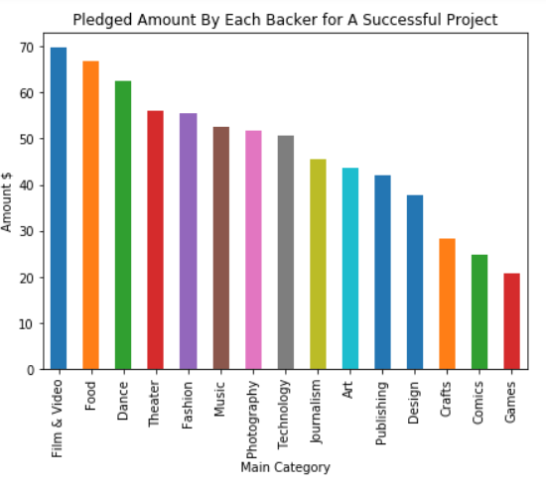

Slide 17
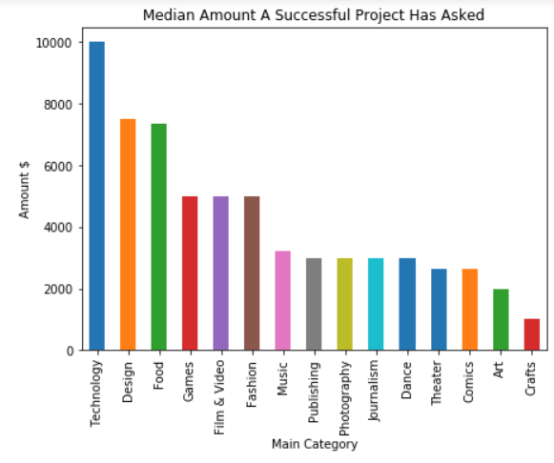

Slide 18
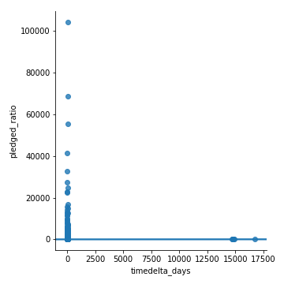
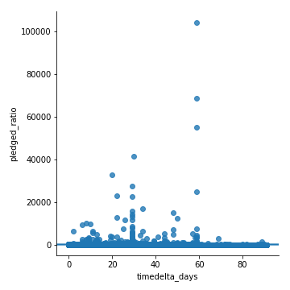

Slide 20
Conclusion
We found
Which projects have a better chance to succeed
Increase in Pledged / Goal Ratio over the years
Increasing number of days doesn’t increase the chance of success
The most common amount a project can ask for in each category

Slide 21


